Slide 1
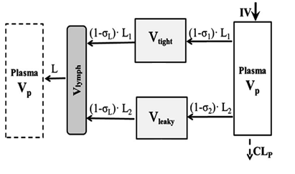
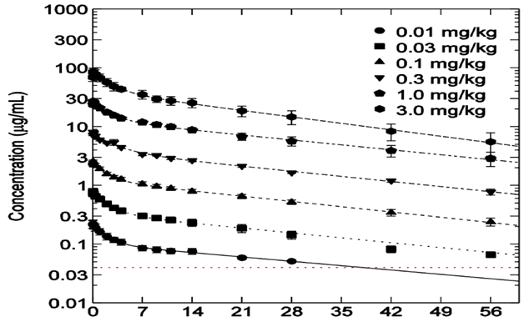
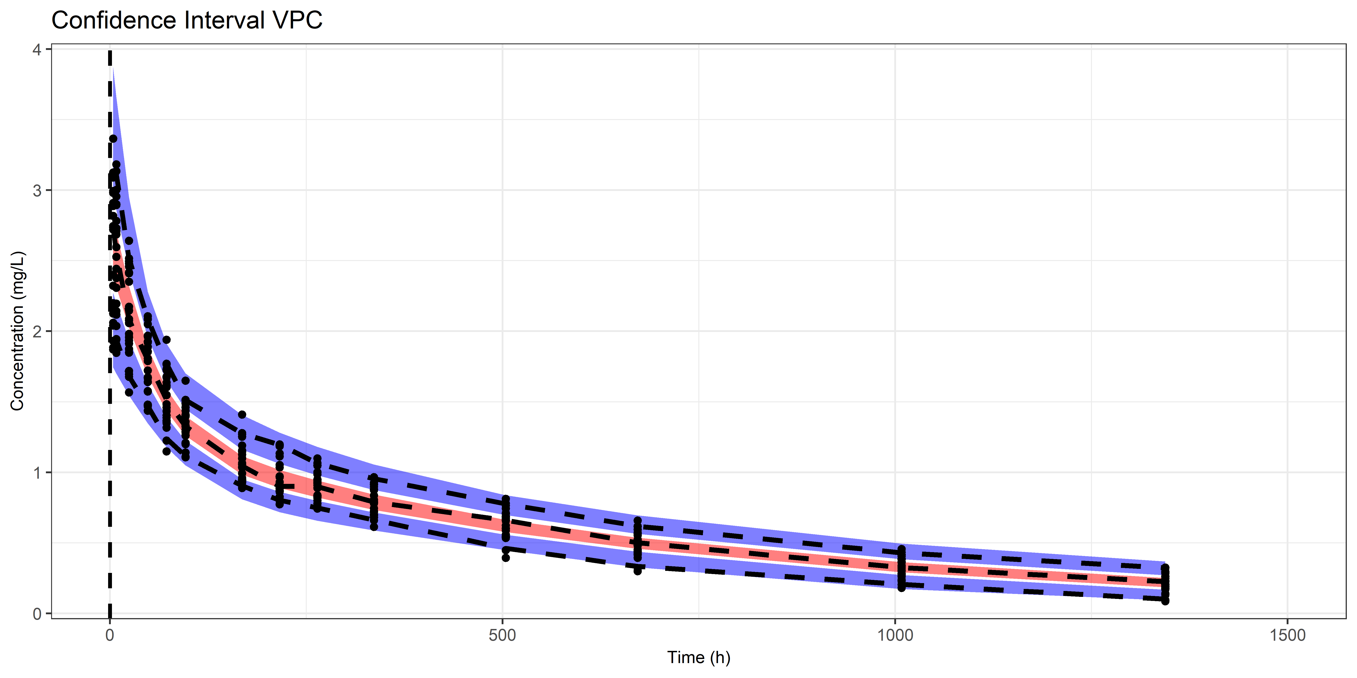
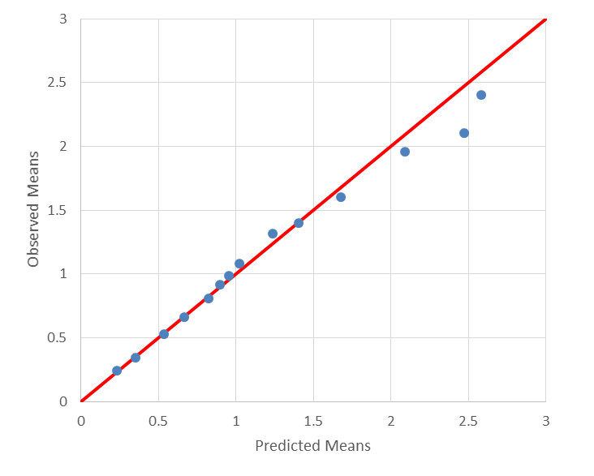
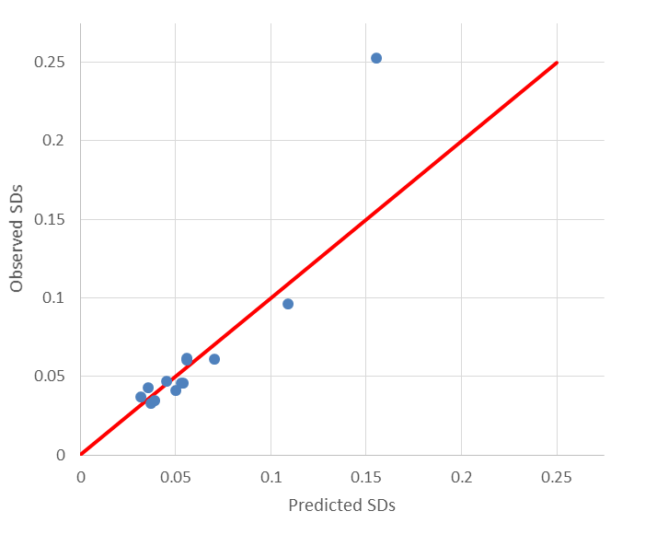
A methodology to estimate population pharmacokinetic
parameters from aggregate concentration-time data and its application to gevokizumab
Evangelos Karakitsios and Aris Dokoumetzidis
Department of Pharmacy, University of Athens, Greece
Objectives
Application to gevokizumab
The aim of the present study was to develop and assess the performance of a methodology to estimate the population pharmacokinetic (PK) parameters along with the Inter-Individual Variabilities (IIVs) from reported aggregate concentration-time data, in particular mean plasma concentrations and their standard deviations (SDs) versus time, such as those often found in published graphs. This method was applied to published data of gevokizumab, a novel monoclonal anti-interleukin-1β antibody in order to estimate population pharmacokinetic (PopPK) parameters of a minimal physiological pharmacokinetic model (mPBPK).
Finally, the method was applied to scanned aggregate data (shown in Figure 3) from literature of gevokizumab’s IV bolus administration to diabetic patients [2] to estimate the population PK parameters of an mPBPK model of the drug. These aggregate data (mean plasma concentrations and their SDs versus time) were derived from 10 patients (N=10) for all dose groups (0.01,0.03,0.1,0.3 and 1.0 mg/kg) except for one (3.0 mg/kg, N=5). The estimates of the pharmacokinetic parameters of gevokizumab took the values shown in Table 2, with the respective Standard Errors (SE %) shown in the parentheses, concerning three different indicative dose groups as well as all the dose groups with a naïve pooled approach. Also, goodness of fit plots are presented for dose 0.1mg/kg in Figure 4.
Figure 1. The minimal PBPK model (IV bolus administration) that
was used for describing the population pharmacokinetic behavior of gevokizumab.
Also, a Representative Visual Predictive Check (VPC) from the simulated datasets was plotted. The VPC is shown in Figure 2. The black dashed lines in the plot are the 5th, 50th and 95th percentiles of the plasma concentrations of the original dataset.
The model was fitted to the mean concentrations and SDs of the original dataset in order to estimate the 5 population parameters of gevokizumab. These estimated parameter values were used to simulate 1000 datasets same as the original ones. The filled areas in the plot of Figure 2 represent the 95% CI for the 5th, 50th and 95th percentiles of the prediction intervals, where the red areas relate to the medians. Conclusively, the model can predict the original dataset, derived from 24 patients, although only the mean plasma concentrations and their respective SDs were used for the fitting. Repeating the VPC for 10 patients results to a similar plot showing good predictions, with slightly wider CIs.
28th PAGE Meeting Stockholm Sweden, 11-14 June, 2019 Poster IV-71
Method
Figure 3. The published graph with aggregate data that was used for estimating the gevokizumab’s PopPK parameters.
A function was constructed in R based on an mPBPK model [1] that predicts (output) the mean concentrations and their standard deviations from a Monte Carlo (MC) simulation of a number of patients generated from the distributions of the mPBPK model parameters including IIVs for some of them (input). The model was parametrized in terms of the vascular reflection coefficients σ₁ and σ₂ for tight and leaky tissues, respectively, drug plasma clearance CLp, and the IIV terms ω_{CLp} and ω_{V}, for the SD of the lognormal distributions of plasma clearance and volume of human body respectively. This function was fitted to data of mean concentrations and SDs in order to estimate the population PK parameters using Maximum likelihood method with a quasi-Newton optimiser. Latin Hypercube sampling was used for the MC step to improve speed. Also, two separate exponential residual error terms were assumed, one for the means and one for the SDs. The entire analysis was performed using R software (RStudio).
Time (days)
Table 2: Gevokizumab population pharmacokinetic model parameter estimates
Parameter estimate (SE%)
 | 0.1 mg/kg | 0.3 mg/kg |  |  | 1.0 mg/kg |  | All doses
Base Model Parameters
σ₁ | 0.996 (3.76) |  | 0.941 (3.54) | 0.930 (2.28) |  | 0.973 (3.37)
σ₂ | 0.738 (3.48) |  | 0.843 (3.31) | 0.830 (2.15) |  | 0.750 (3.10)
CLp (L/hr) | 0.00660 (0.0173) |  | 0.00601 (0.0162) | 0.00580 (0.0104) |  | 0.00652 (0.0168)
Interindividual Variability
ω_{CLp} (%) | 7.30 (0.793) |  | 3.71 (0.986) | 18.4 (0.472) |  | 9.74 (1.36)
ω_{V} (%) | 6.89 (0.543) |  | 9.05 (1.13) | 7.95 (0.510) |  | 10.2 (1.08)
Residual Variability
sigma₁ (%) | 5.87 (1.12) |  | 6.05 (1.15) | 3.62 (0.688) |  | 11.2 (0.958)
sigma₂ (%) | 19.0 (3.74) |  | 32.2 (6.60) | 3.05 (0.770) |  | 46.1 (4.81)
Evaluation of performance
To evaluate the performance of the method, simulations and estimations were carried out. Each simulated dataset consisted of the mean plasma concentrations and their SDs that were derived from 24 individuals – a typical number of patients in clinical trials. The parameter values used for the simulation studies were chosen to reflect those of gevokizumab [1]: σ₁=0.931, σ₂=0.837, CLp=0.00668 L/hr, ω_{CLp}=20%, ω_{V}=20%, residual variability (rv)=5% and the dose was set to 7 mg.
By simulations and estimations the bias and precision of the estimates, was calculated, from 1000 simulated datasets. Different scenarios in the investigation included two levels of residual variability added to the simulated values, 5% and 10%. Also, another simulation study was applied with 5% residual variability and 10 patients, instead of 24, in the simulated dataset. All options considered in the simulation study are summarized in Table 1, showing the bias (percent mean Relative BIAS - %RBIAS) as well as the precision (percent Relative root Mean Squared Error - %RMSE and percent Relative Absolute Error - %RAE) of the estimates. The results show that the method is capable of estimating all the parameters with satisfactory bias and precision.
Figure 2. VPC plot with 24 random patients in the simulated original dataset.
Mean Concentrations
Concentration SDs
Table 1. Summary of the entire simulation study.
 |  |  | 1st Sim. Study (rv=5%, N=24) | 2nd Sim. Study (rv=10%, N=24) | 3rd Sim. Study (rv=5%, N=10)
Mean Population Values | σ₁ | %RBIAS | -0.11 | 0.12 | -0.11
 |  | %RMSE | 1.25 | 1.56 | 2.05
 |  | %RAE | 0.91 | 1.24 | 1.40
 | σ₂ | %RBIAS | 0.15 | -0.027 | -0.063
 |  | %RMSE | 1.81 | 2.24 | 2.87
 |  | %RAE | 1.39 | 1.77 | 2.23
 | CLp | %RBIAS | -0.14 | -0.65 | 0.068
 |  | %RMSE | 0.62 | 1.21 | 7.32
 |  | %RAE | 0.49 | 0.97 | 1.00
Interindividual Variabilities | ω_{CLp} | %RBIAS | -6.62 | 0.38 | -7.24
 |  | %RMSE | 8.14 | 6.84 | 12.2
 |  | %RAE | 7.00 | 5.37 | 8.99
 | ω_{V} | %RBIAS | 5.81 | 22.8 | 5.68
 |  | %RMSE | 8.96 | 25.0 | 12.0
 |  | %RAE | 7.16 | 22.8 | 9.29
Figure 4: Observed vs predicted mean concentrations (left) and concentration SDs (right) for dose 0.1 mg/kg
Conclusions
We present a methodology to estimate population pharmacokinetic parameters using only patients’ mean plasma concentrations and their SDs vs time. The methodology describes adequately simulated data, indicating that the loss of information from averaging can be recovered. This method could be applied to any PK model in order to estimate PopPK parameters when only a published graph with mean plasma concentrations and SDs is available.
References
1. Cao Y, Balthasar JP, Jusko WJ. Second-generation minimal physiologically-based pharmacokinetic model for monoclonal antibodies. J Pharmacokinet Pharmacodyn. 2013;40:597–607.
2. Cavelti-Weder C, Babians-Brunner A, Keller C, Stahel MA, Kurz-Levin M, Zayed H, Solinger AM, Mandrup-Poulsen T, Dinarello CA, Donath MY. Effects of gevokizumab on glycemia and inflammatory markers in type 2 diabetes. Diabetes Care. 2012;35:1654–1662.

